Slide 1

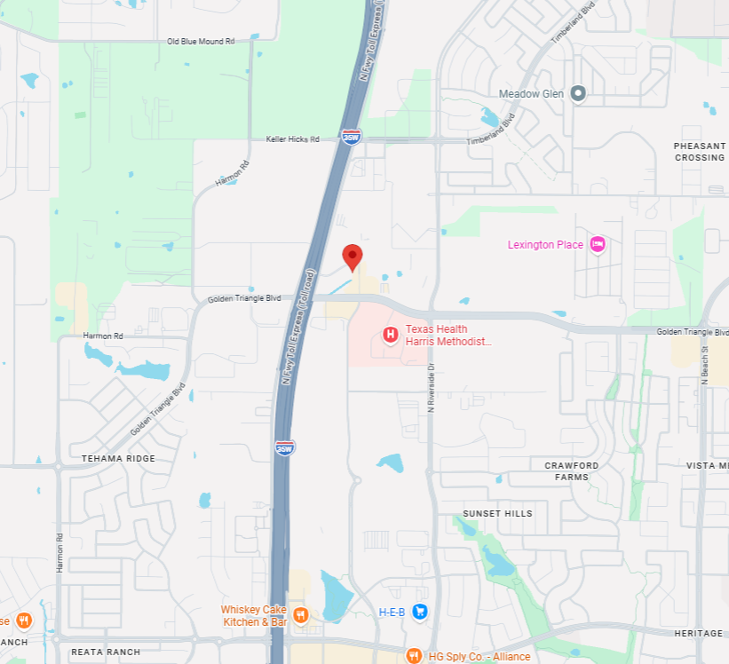
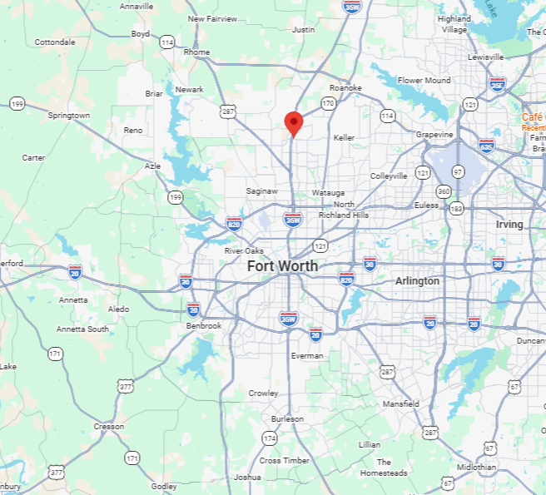


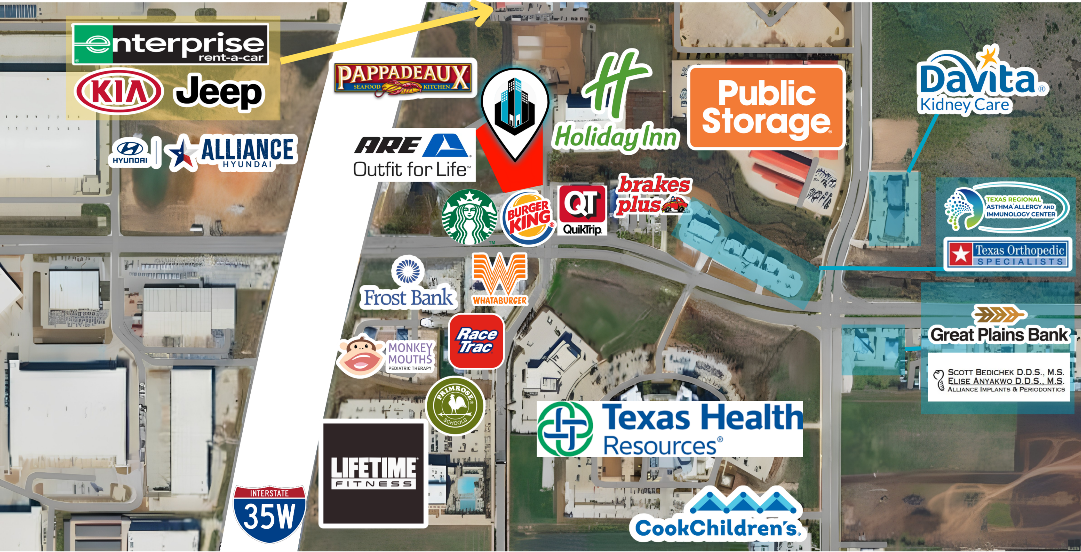

STRATEGIC LOCATION
ADDISON RESTAURANT ROW, BELT LINE RD.
3121 BAILEY DR. FORT WORTH, TX
VEHICLES PER DAY
120,000+ VPD
On I-35W / I-35W TEXpress & Golden Triangle
WORKFORCE
Over 233K
Within 5-mile radius
DFW AIRPORT
30 Min
Dallas/Fort Worth International
ALLIANCE AIRPORT
8 Min
Perot Field Fort Worth Alliance Airport
EUREKA BUSINESS GROUP · EBGTX.COM
LOCATION OVERVIEW · 3121 BAILEY DR. FORT WORTH, TX

Slide 2
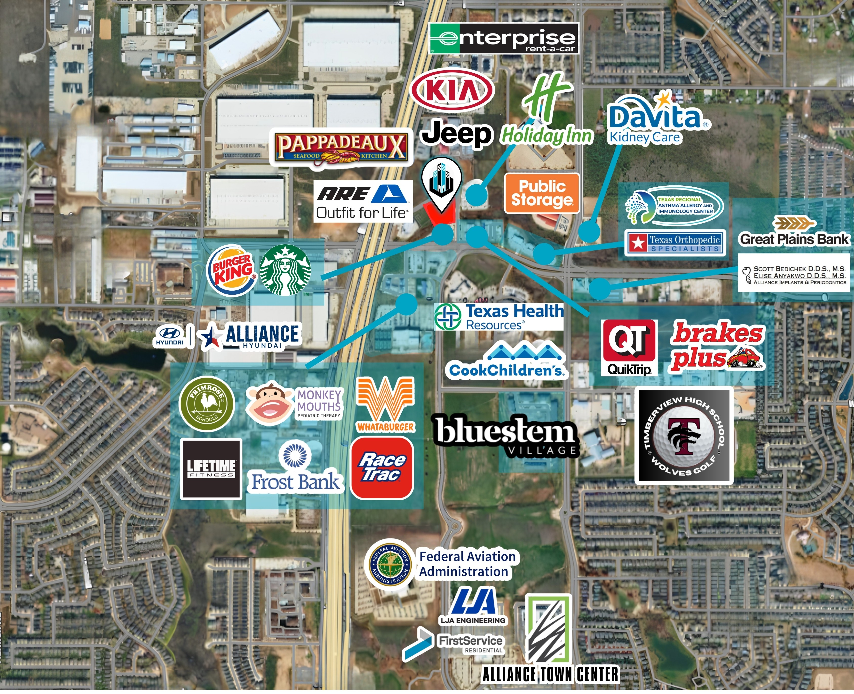
SURROUNDING RETAIL & CO-TENANCY
KEY RETAILERS IN TRADE AREA
Grocery / Warehouse
Costco, WinCo Foods, Kroger
Department / Big Box
Target, JCPenney, TJ Maxx, At Home
QSR / Restaurant
Starbucks, In-N-Out, Chick-fil-A, Pappadeaux, MOD Pizza
Convenience / Gas
QuikTrip, 7-Eleven
Home / Lifestyle
Petco, La Madeleine, Sam Moon, ULTA
Health / Fitness
Texas Health Resources, Lifetime Fitness
Entertainment
Main Event, CityVet
Auto
AutoNation, Jeep
Financial / Services
PNC Bank
Dining
Burger King, Crumbl, Rosati's Pizza
EUREKA BUSINESS GROUP · EBGTX.COM
SURROUNDING RETAIL & CO-TENANCY · 3121 BAILEY DR. FORT WORTH, TX

